Slide 1

Juno Lighting Group System Migration
Packaging/Labeling Changes
3/24/17

Slide 2
Confidentiality Statement
The information in this presentation is confidential and proprietary, and may not be used, reproduced or distributed without the express written permission of Acuity Brands Lighting, Inc.

Slide 3
Packaging/labeling Changes
We are preparing for the upcoming system migration bringing the Juno Lighting Group brands to Acuity Brands systems
This migration has required some nomenclature changes to the existing Juno Lighting Group products.
  Some of these changes are minor such as adding or taking away space or eliminating dashes
  Other products will have a bigger change
In order to get ahead of this with packaging and labeling, we have implemented a system to include both the old and new nomenclature.
Both the new and old nomenclature will be in the Cat No field on the labels. The old nomenclature will be in parentheses under the new nomenclature
We will be sending additional updates and providing tools to help facilitate the changes

Slide 4
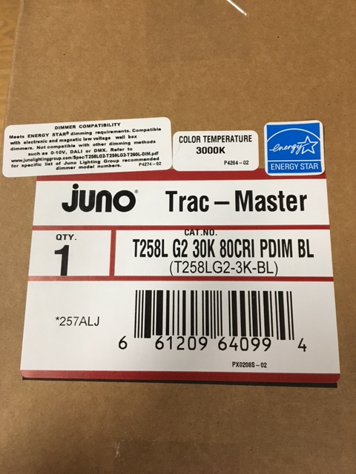
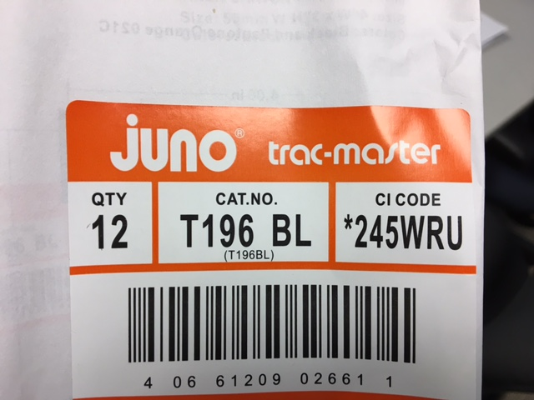
Packaging Labeling Changes 1 of 3
Examples of 5 elements on new labels
Purchased FG
(Group 1 Product)
Manufactured in DP
(Group 2 Product)
Future AB Nomenclature
(BAAN Legacy Number)

Slide 5
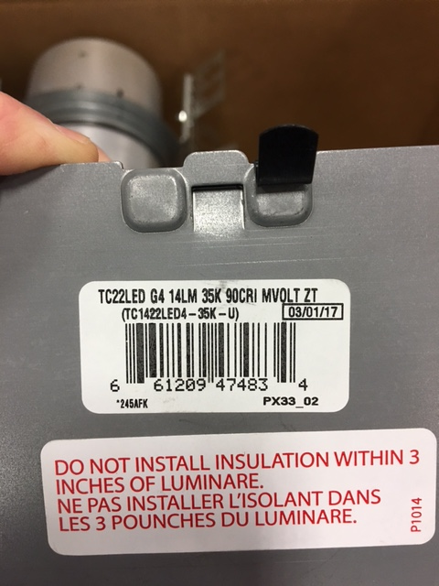
Packaging Labeling Changes 2 of 3
Example of Product Labels with old and new cat number, CI Code & UPC
New Cat No, Old Cat No., CI Code
and UPC on J-Box cover.
Future AB Nomenclature
(BAAN Legacy Number)

Slide 6
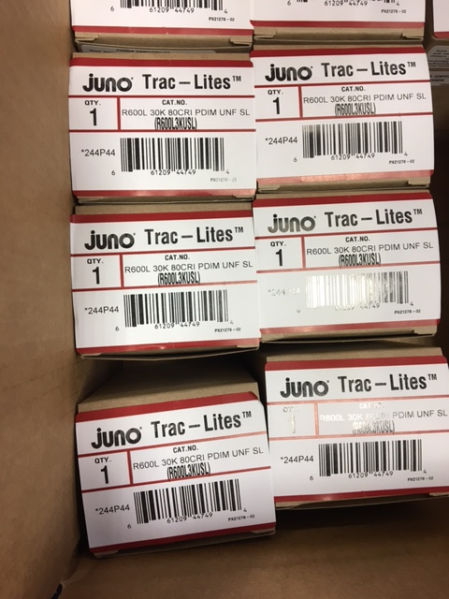
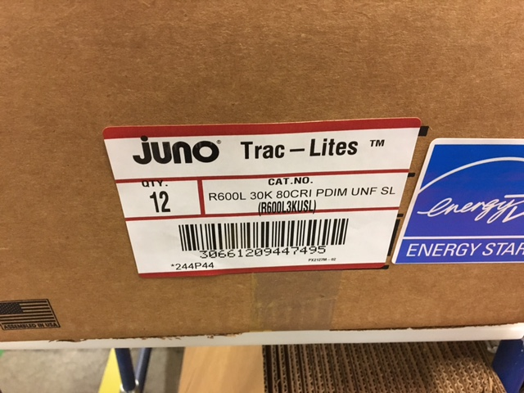
Packaging Labeling Changes 3 of 3
Example of Inner and Outer Cartons DP
Future AB Nomenclature
(BAAN Legacy Number)

